Slide 1

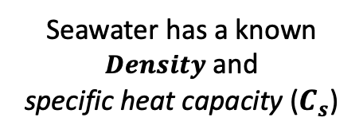

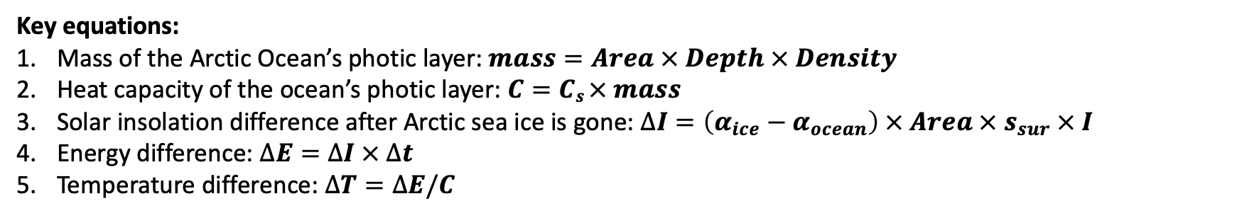
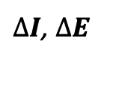
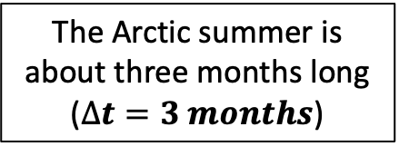


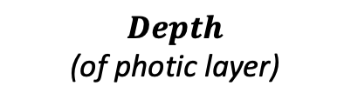

In the Ice-Free Arctic CGI, there are a lot of crazy units – but fortunately, Python has pint
The Arctic summer is about three months long ($∆t=3 months$)
$$I$$
clouds
$$s_{sur}$$
$α$_{ocean}
$Area$ (of ice-covered Arctic Ocean)
$α$_{ice}
$∆I$, $∆E$
Seawater has a known $Density$ and
specific heat capacity ($C_{s}$)
$Depth$
(of photic layer)
Key equations:
Mass of the Arctic Ocean’s photic layer: $mass=Area × Depth × Density$
Heat capacity of the ocean’s photic layer: $C=Cs × mass$
Solar insolation difference after Arctic sea ice is gone: $∆I=\left(α_{ice}−α_{ocean}\right) × Area × s_{sur} × I$
Energy difference: $∆E=∆I × ∆t$
Temperature difference: $∆T=∆E/C$

Slide 2
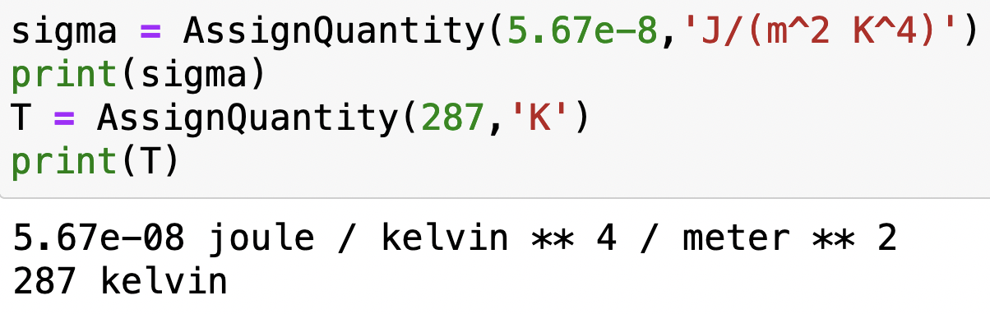
Using pint
Here’s how you bring pint into your Python notebook
Super-handy because AssignQuantity attaches units for you:

Slide 3
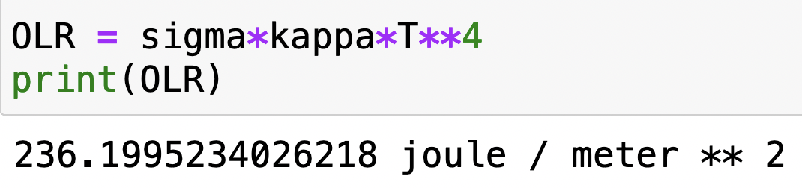
Using pint
pint also calculates units of the results of calculations:

Slide 4
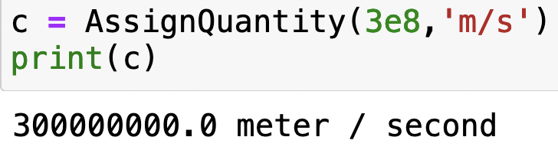
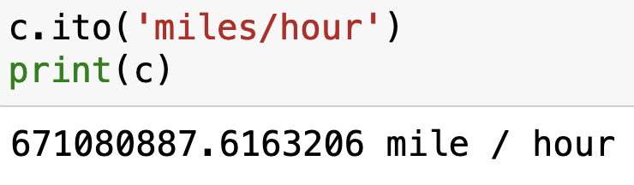
Using pint
pint can also do conversions for you, using “.ito”

Slide 5
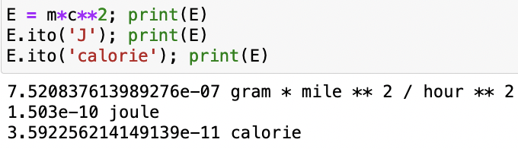
Using pint
Conversions can be very handy for unraveling calculations in crazy units. For example, Einstein’s formula for the equivalence of mass and energy is
$$E=mc^{2}$$
What if you specified mass in grams and speed in miles/hour? The result would have units gram mile² / hour², right? But nobody thinks about energy in those units, they think about energy in joules (or calories or btu or ergs ...). Fortunately, pint knows a lot of units:

Slide 6
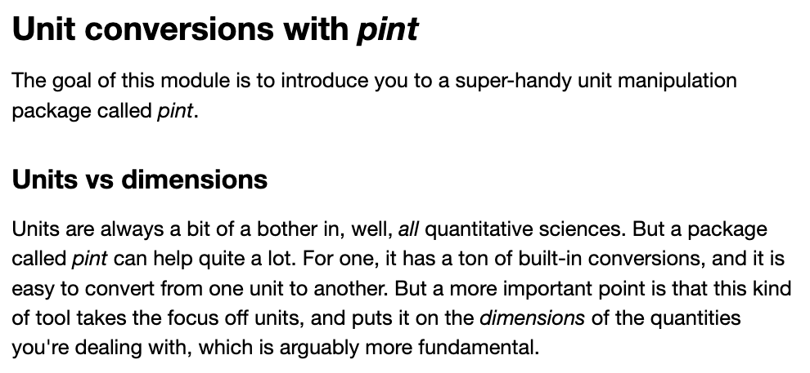
OK, let’s get started

